Slide 1
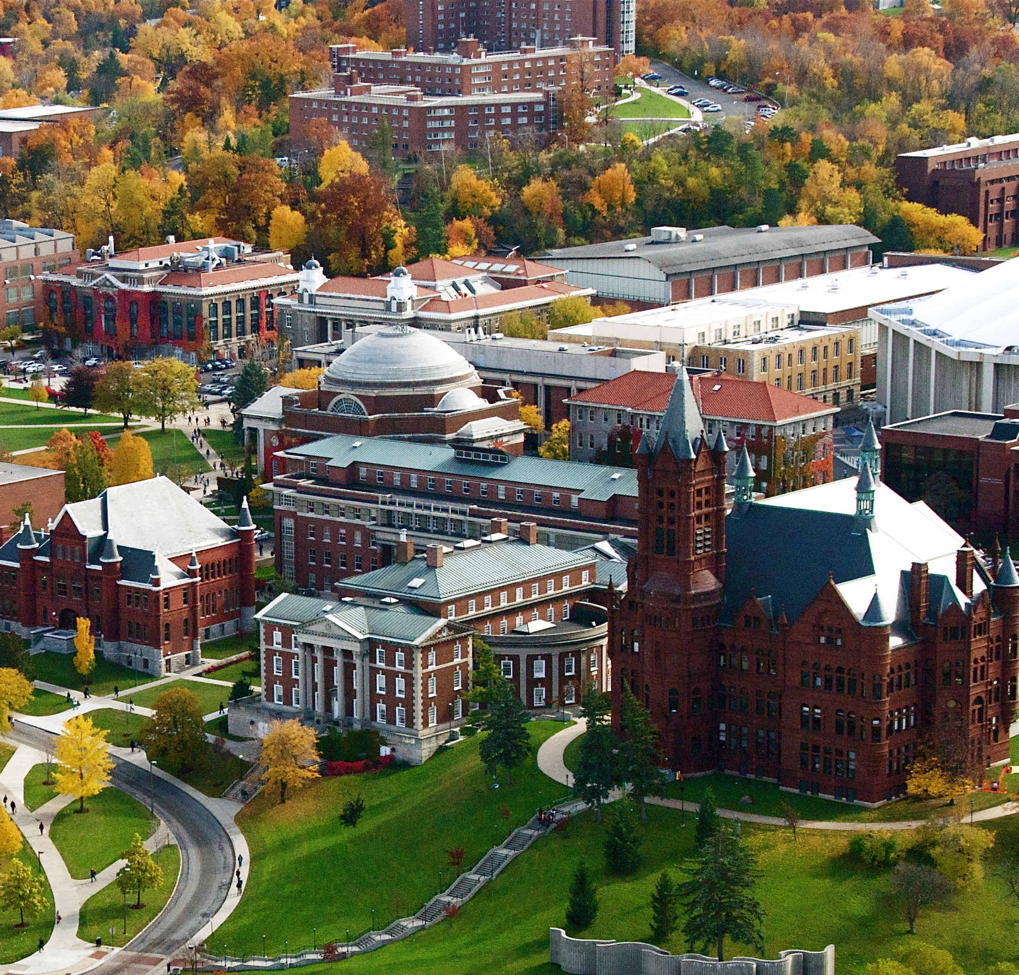
Jeremiah Graff Portfolio Slide Submission
School of Information Studies
Whitman School of Management

Slide 2
Portfolio Overview
Level of Knowledge
Projects that provided the knowledge
Conclusion

Slide 3
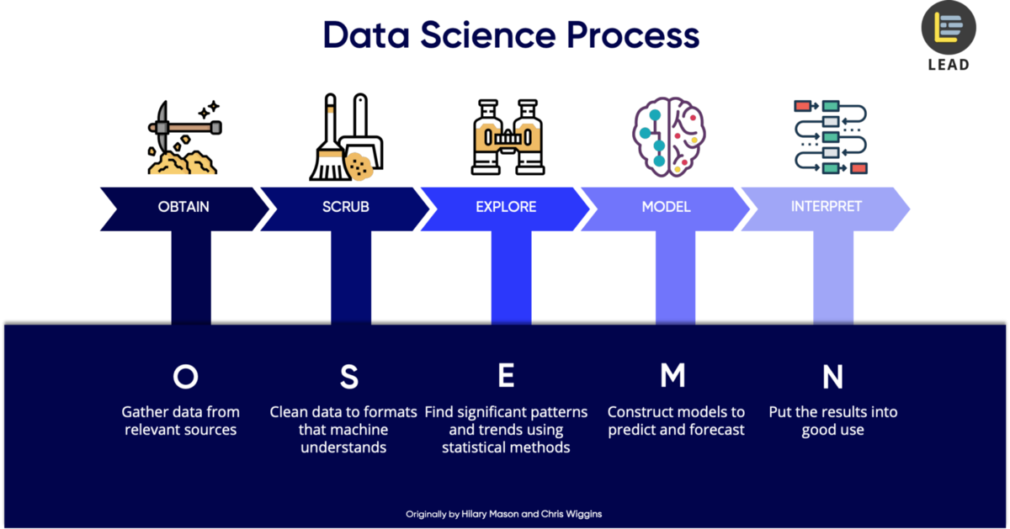
Level of Knowledge: What does it mean to be a data scientist?
OSEMiN
Obtain
Scrub
Explore: Visualize, aggregate, discover
Model
Interpret: Technical/Non-technical
Descriptive/Predictive/Prescriptive Statistics
Ethics
https://www.google.com/url?sa=i&url=https%3A%2F%2Ftowardsdatascience.com%2F5-steps-of-a-data-science-project-lifecycle-26c50372b492&psig=AOvVaw02xPIuY60wbeBZdF_-TsRP&ust=1599275630263000&source=images&cd=vfe&ved=0CAMQjB1qFwoTCKCoyJLEzusCFQAAAAAdAAAAABAD

Slide 4

Project 1
IST 687: Intro to Data Science Final Project

Slide 5
IST 687: Intro to Data Science Class/Final Project Learnings
Goal of Project
Examine dataset with 129,000 rows of flight info and provide actionable insights as a consultant to one of the airlines contained within based on the satisfaction scores of the flights.
First exposure to:
R
Algorithms: Support Vector Machines & Naïve Bayes
Text Mining – data prep
Association Rule Mining
Basics of visualization in R
Exploratory Data Analysis
Inferential Statistics

Slide 6
Project 2
IST 736: Text Mining Final Project

Slide 7
IST 736: Text Mining Class/Final Project Learnings
Goal of Project
Examine the presidential nomination acceptance speeches from 1900 to 2016 to see if they can provide some level of certainty in predicting: winner, party, DJIA, sentiment, incumbent party/president, etc. (15 total variables)
Broader exposure to:
Python
Text Mining data gathering/preparation
Experience with the need to process different portions within a dataset differently
Visualizing textual data/results of the analysis
Document clustering and topic modeling

Slide 8
Project 3
IST 719: Information Visualization Poster

Slide 9
IST 719: Information Visualization Class/Final Project Learnings
Goal of project:
Create a poster using the principles learned in the class to effectively communicate the insights within the data, in this instance, communicate the distribution of Wins Above Replacement in Major League Baseball.
Broader exposure to:
Science behind visualization
Art of creating something that will resonate and guide the readers’ path
The impact of a well-constructed visualization to provide actionable insights

Slide 10
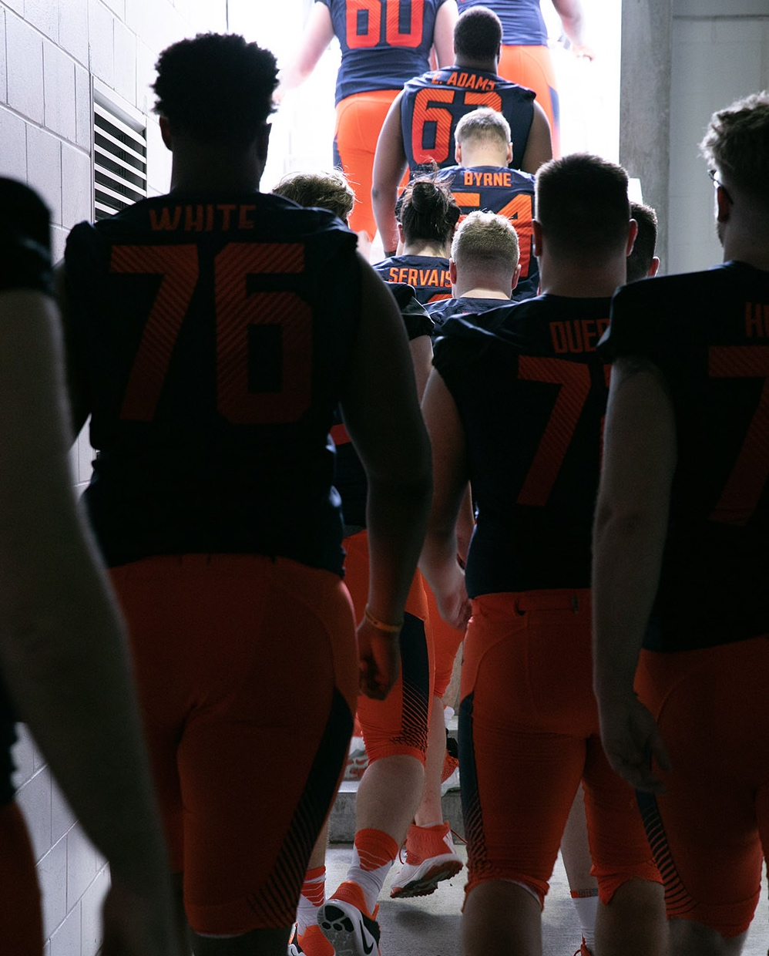
Project 4
IST 718: Big Data Analytics Lab #1

Slide 11
IST 718: Big Data Analytics Class/Final Project Learnings
Goal of Project:
Predict the salary of the next Syracuse head football coach for multiple conferences, report the accuracy of each of the models run, report which variable had the largest impact on the projected salary and what effect did certain variables have on the projected salary.
Broader exposure to:
TensorFlow/Machine Learning
Time Series Forecasting using ARIMA/FB Prophet
Breaking down and learning how to access the different components of the ordinary least squares (linear regression model) with Python code
Association Rule Mining, Clustering, Conjoint Analysis

Slide 12
Thank you for your time and consideration!
Jeremiah Graff
MS Applied Data Science Candidate
jgraff@syr.edu
209-485-8026

